Slide 1
Title
Back
Form
Cancel
Save
Done
Done
Done
Back
Back
Back
Menu
Menu
Menu
Search...
Active search

Slide 2
Tab A
Tab B
Tab C
This is a simple connected tab that sets
the on tab to the content clock to visually
connect them and is best for grouping
content inside a panel or page.
Tab A
Tab B
Tab C
This disconnected tab style is good for
cases where tab controls the whole
screen or panel, like in the case of a
toolbar.

Slide 3
    Accordion A
This is an example of an accordion widget
that is used pretty much everywhere on
the web.
    Accordion B
    Accordion C
    Accordion D

Slide 4
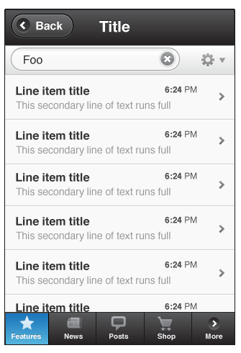
Title
Back
Foo
Line item title
This secondary line of text runs full
6:24 PM
Line item title
This secondary line of text runs full
6:24 PM
Line item title
This secondary line of text runs full
6:24 PM
Line item title
This secondary line of text runs full
6:24 PM
Line item title
This secondary line of text runs full
6:24 PM
Line item title
This secondary line of text runs full
6:24 PM
Features
News
Posts
Shop
More

Slide 5
Simple list item, selected
Simple list item, checked
Simple, drilldown
Simple, optional drilldown
Advanced, drilldown
Clicking the row drills to a new view
6:24 PM
Simple, optional drilldownl
Clicking row selects, blue arrow drills
6:24 PM
Thumbnail
Thumbnail

Slide 6
Thumbnail, drilldown
Thumbnail
Thumbnail, optional drill
Thumbnail
Thumbnail
Adv. Thumbnail
Each has a 60px image
6:24 PM
Thumbnail
Adv. Thumbnail
Each has a 60px image
6:24 PM
Sortable list
Grouping July 15, 2010
3
List Divider

Slide 7
Form
Cancel
Save
    Photos
TOGGLE ON
On
TOGGLE OFF
      Off
SLIDER
3 seconds
SEGMENTED
Off
Low
  High
DRILL MENU
3D Cube Flip Flip
POPUP MENU
After 5 minutes
INPUT
John’s Slideshow

Slide 8
DATEPICKER
July 15, 2010
SPINNER
10:30
AM
INPUT
No need to round
these too much or
it takes away a lot
of space for typing.
RADIO
Radio button A
Radio button B
CHECKBOX
Checkbox A
Checkbox B

Slide 9
EMBEDDED DATE PICKER
July 2010
1
2
3
4
5
6
7
8
9
10
11
12
13
14
15
16
17
18
19
20
21
22
23
24
25
26
27
28
29
30
31

Slide 10

PROGRESS BAR 64% Complete
INDETERMINATE PROGRESS BAR
    Albums
12
    Events
7
    Tags

